Slide 1
Final Project CEE-101s-01/MATLAB
Coin Reader
Instructors: Derek Fong / Tracy Mendel
Students: Joseh Suarez
Tiago Oliveira

Slide 2
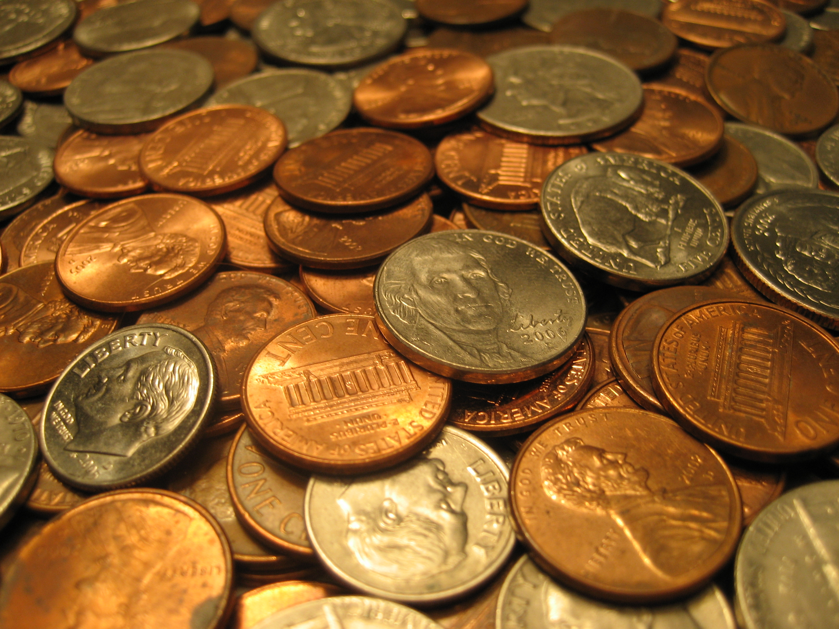
Introduction
What problem does it solve?
How does it work?
Picture taken from: phandroid.com

Slide 3
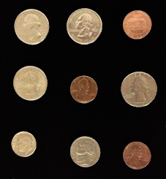
Conditions
Black background
No coins touching
No coins near the edge
At least one coin of each value
No zoomed out images

Slide 4
Methodology
1. Average Background Color 5. Coin Cleaner
2. Coin Finder 6. Penny Finder
3. Triangles 7. Diameter Compare
4. Diameter 8. Final Sum

Slide 5
Calculate Background color
Change the picture to gray scale image (2D matrix)
Calculate the average of the pixel border

Slide 6
Edge Finder and Triangles
Compare pixels iteratively
Condition to enter Triangles:
| Pixel - Background | > Threshold
Draw a triangle and find the
the average color
Check color vs. background

Slide 7
Diameter and Coin Cleaner
Check pixel 3 by 3
Figure out the diameter
Draw a box

Slide 8
Penny Evaluation
Take RGB average for each coin
[R, G, B] → [(R-B),(G-B), Ø]
[(R-B),(G-B), Ø] → [(R-B)-(G-B), Ø, Ø]
Grey : 20 > value > 30
Penny: value > 32

Slide 9
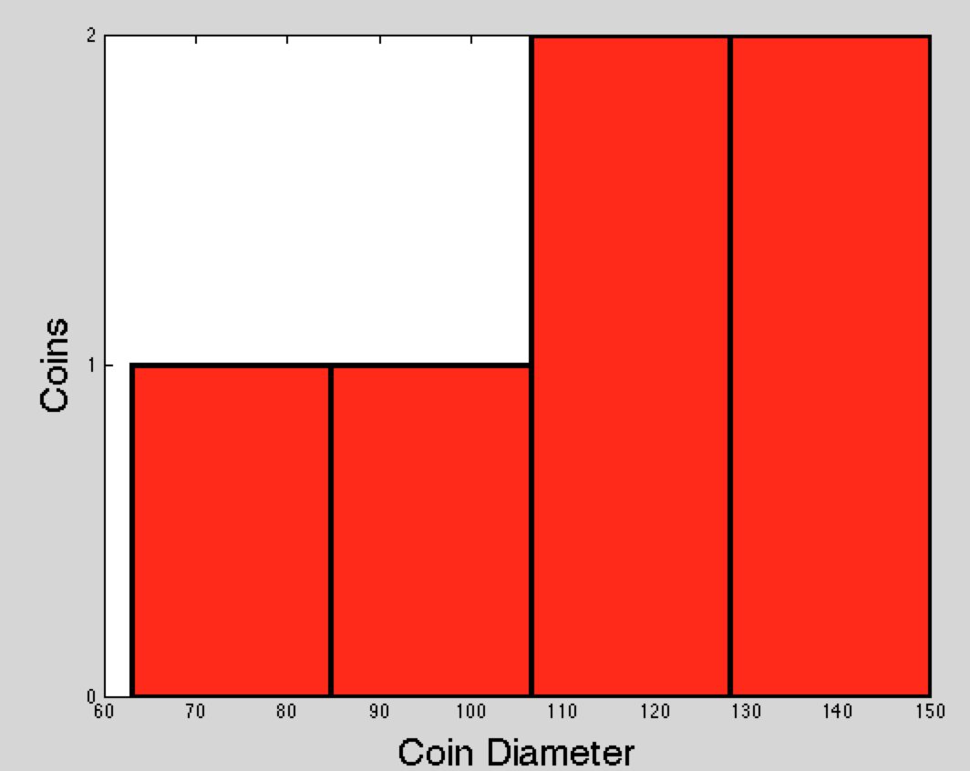
Diameter Compare
Input: Array of diameters
Output: Array containing the number of each coin type
Method: Repeatedly count the number of “wide” coins and remove them from the array.
[150, 113, 88, 117, 149, 63]
[2, 2, 1, 1]

Slide 10
Final Sum
[2, 2, 1, 1]
[1.00, 0.25, 0.05, 0.10, 0.01]
Input from Diameter Compare:
*
+
0.50, 0.10, 0.10, 0.01
$ 0.71

Slide 11
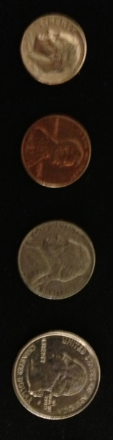
Examples
Sum: $ 2.68
Sum: $ 0.41

Slide 12
Thank you!
Questions?

